Slide 1
How To Learn SQL
For
Data Science

Slide 2
What is SQL
Structured Query Language
SQL is designed for managing data in a relational database management system (RDBMS). SQL is a database language, it is used for database creation, deletion, fetching rows, and modifying rows, etc.

Slide 3
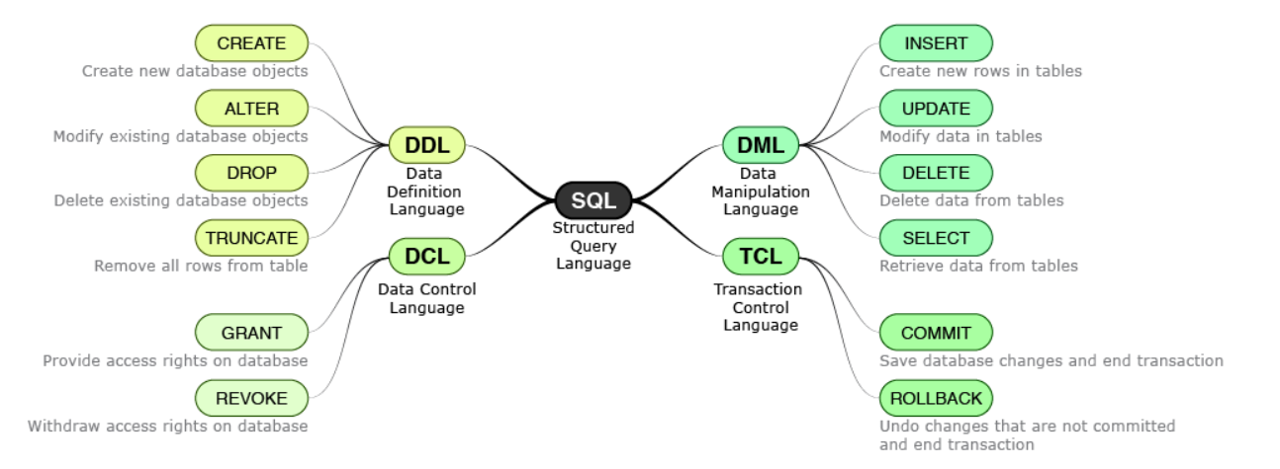
What is SQL

Slide 4
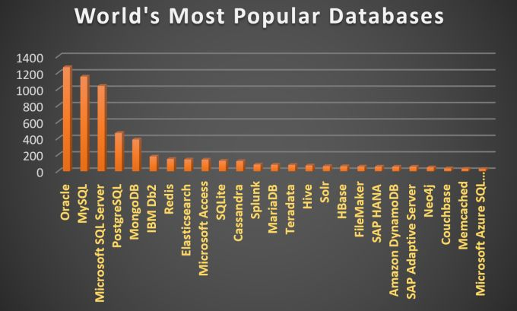
Why is SQL so important?
Cloud Technologies
Big Data Technologies

Slide 5
Why is SQL important in Data Science?
The not so evolved Data ecosystem.
Initial Understanding of the data

Slide 6
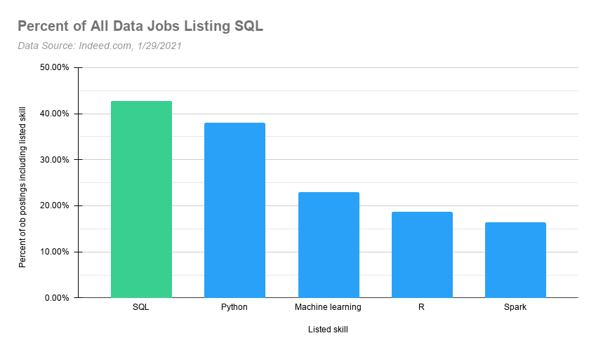
Why you should learn SQL?
Data Scientist
Data Analyst
Data Engineer

Slide 7
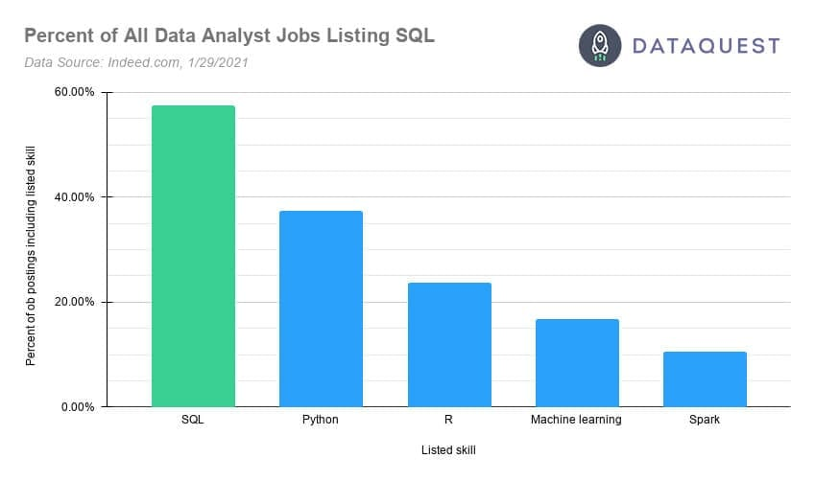
Why you should learn SQL?
Entry-level Jobs

Slide 8
FAQs
Is it hard to learn SQL?
Which database should we choose?

Slide 9
What exactly to learn?
DML Commands - INSERT, SELECT, DELETE, UPDATE, WHERE, ORDER BY
SQL Joins
Subquery and temp tables
SQL Cases
Stored Procedures and Functions
Window Functions

Slide 10
What exactly to learn?
Data types
Normalization and Denormalization
Indexing
Query Optimization Practices
Schema Design (Creating Databases and Tables)

Slide 11
Resources

Slide 12
My Advise
Practice a lot
Don’t just learn to crack interviews

